Slide 1
Scraping data online

Slide 2
Contents
Scraping data from the web
Using browser plug-ins to scrape data tables
Exercise
Using Google docs to import data into charts
Exercise
Summary & Resources

Slide 3
Contents
Scraping data from the web
Using browser plug-ins to scrape data tables
Exercise
Using Google docs to import data into charts
Exercise
Summary & Resources

Slide 4
Scraping data using plug-ins
Browser scrapers:
Dafizilla Table2Clipboard for Mozilla Firefox
Scraper Extension for Chrome
Allow you to select tables on a website, including specific rows and columns
Copy the data tables and either create a Google spreadsheet or paste into a blank Excel file

Slide 5
Contents
Scraping data from the web
Using browser plug-ins to scrape data tables
Exercise
Using Google docs to import data into charts
Exercise
Summary & Resources

Slide 6
Scraping data using browser extensions exercise
The appropriate browser extension should be installed:
Dafizilla Table2Clipboard for Mozilla Firefox
Scraper Extension for Chrome
Go to: https://www.quandl.com/c/health/afghanistan-all-health-indicators

Slide 7
Scraping data using browser extensions exercise
If you are using the Chrome, highlight part of the table, right click and select ‘Scrape similar’ then Export to Google docs.
If you are using Mozilla, right click on the table and select “Table2Clipboard’ and copy whole table. Then open an Excel file and paste.

Slide 8
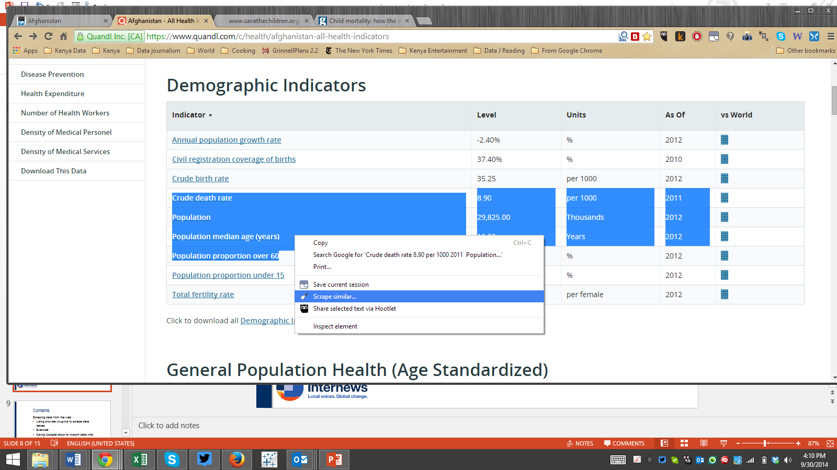
Scraping data using browser extensions exercise

Slide 9
Scraping data using browser extensions exercise
Try again with: https://eads.usaid.gov/usoda/data/profile.cfm
http://www.unicef.org/infobycountry/afghanistan_statistics.html

Slide 10
Contents
Scraping data from the web
Using browser plug-ins to scrape data tables
Exercise
Using Google docs to import data into charts
Exercise
Summary & Resources

Slide 11
Scraping data using Google spreadsheets and Import HTML
Open http://en.wikipedia.org/wiki/China_at_the_Olympics
Open a Google Spreadsheet
Type in =importHTML("http://en.wikipedia.org/wiki/China_at_the_Olympics","table",7)
=function(“url”, “object” , number)

Slide 12
Scraping data using Google spreadsheets and Import HTML
Open http://en.wikipedia.org/wiki/China_at_the_Olympics
Open a Google Spreadsheet
Type in =importHTML("http://en.wikipedia.org/wiki/China_at_the_Olympics","table",7)
=function(“url”, “object” , number)

Slide 13
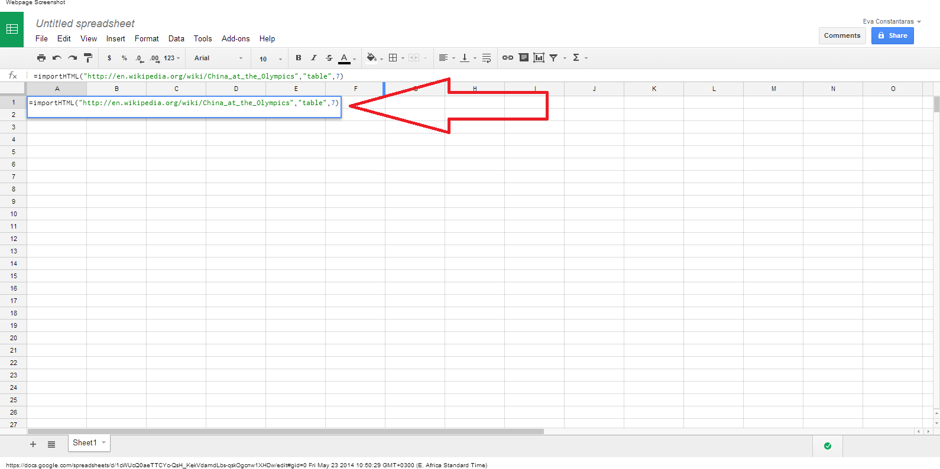
Scraping data using Google spreadsheets and Import HTML

Slide 14
Contents
Scraping data from the web
Using browser plug-ins to scrape data tables
Exercise
Using Google docs to import data into charts
Exercise
Summary & Resources

Slide 15
Scraping data exercise
Visit the Census Website: http://cso.gov.af/Content/files/015%20Donor%20Assistance.pdf .
Find donor data for your reporting.
Try to scrape the budgets.
Can you find a better way to search the CSO site? Try “filetype:” and “site:” shortcuts that you learned in the session on searching for data on the web.

Slide 16
Contents
Scraping data from the web
Using browser plug-ins to scrape data tables
Exercise
Using Google docs to import data into charts
Exercise
Summary & Resources

Slide 17
Summary and Resources
Need help scraping your data from the web?
Ask the School of Data
Join the data driven journalism listserve
Join the Hacks/Hackers Nairobi Google group and go to the next meeting or post your question and ask for volunteers
Visit the Internews data journalism team for
support
Register for a free import.io account and try it out
Try out Outwit Hub

